Slide 1

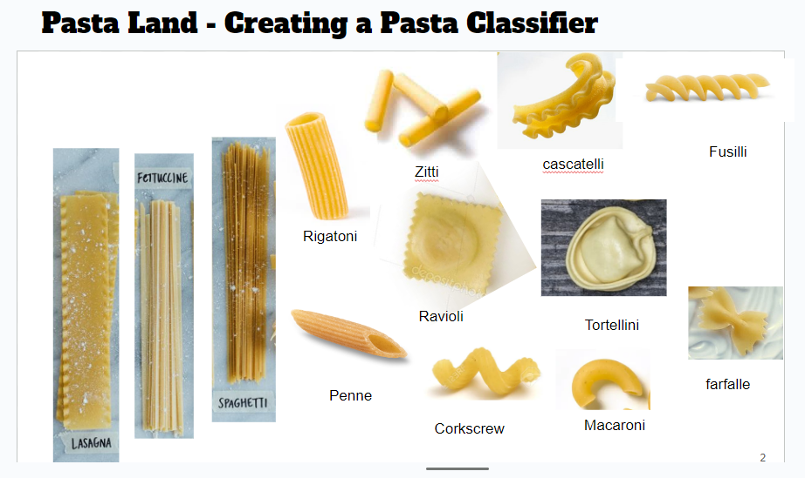

Module 3.2
How can a computer learn to classify objects from examples?
Living and Working with Artificial Intelligence
Developed for the AI4GA (Artificial Intelligence for Georgia) project funded by National Science Foundation awards DRL-2049029 and DRL-2048502.
This work is licensed under the Creative Commons. Attribution-NonComercial-ShareAlike 4.0 International License. https://creativecommons.org/licenses/by-nc-sa/4.0/

Slide 2
Try It #1: Pasta Land - Creating a Pasta Classifier
Setup: (a) Get a big sheet of poster paper for drawing your tree; (b) cut out pictures of pastas (or use real pastas provided by your teacher) that you can move around the nodes of your tree.
Step 1: Propose a bunch of features to distinguish between the pasta types
Step 2: Pick a feature that will split the pastas into two roughly equal groups
Doing this every time will give you the smallest number of questions
This is similar to how real machine learning algorithms decide which feature to use for the next node
Step 3: Take the features, build the decision tree.
Make sure every one of your pasta’s is a leaf
You may not have enough features - if you end up with two types of pasta at the same leaf
Step 4: Test this out and update the features and the tree
Step 5: Convert the tree into a table.
The columns are the features (red - replace question)
The rows are the leaves
If the feature doesn’t apply, put N/A

Slide 3
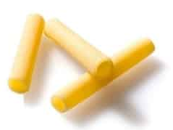
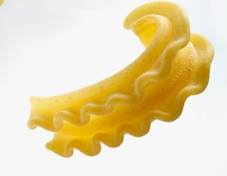
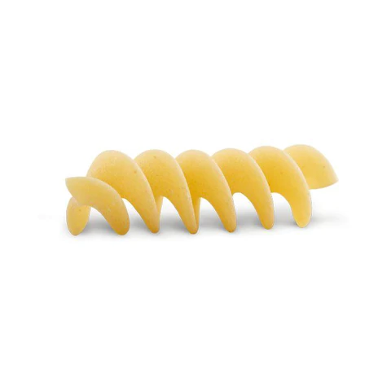
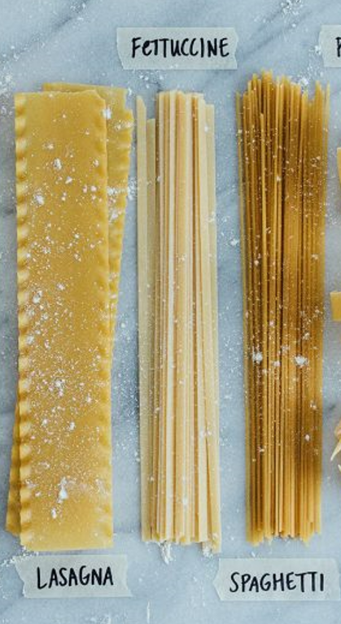
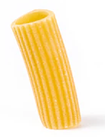
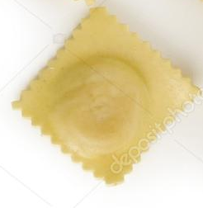
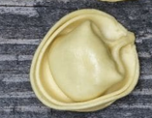
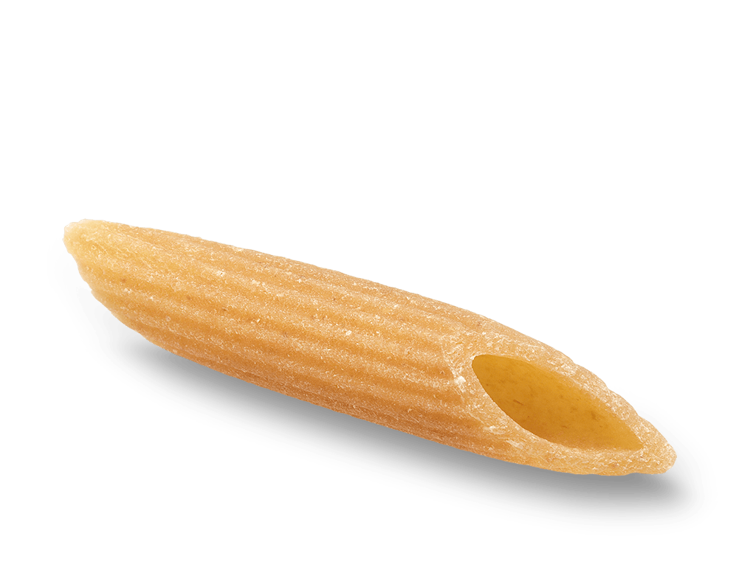
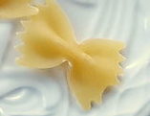
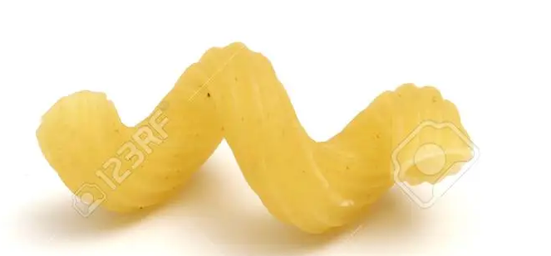
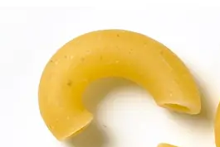
Setup: Distribute Pasta
or cut out
Fusilli
Zitti
cascatelli
Rigatoni
Ravioli
Tortellini
farfalle
Penne
Corkscrew
Macaroni
Notes:
https://www.delish.com/uk/food-news/g31017969/pasta-shapes/
https://en.wikipedia.org/wiki/List_of_pasta

Slide 4
Step 1:
List all the features you think may be useful to distinguish the pastas.
Step 2: Create a root node and place all the pastas there.
Step 3: Pick a feature from the list that splits the pasta examples in the current node roughly in half.
A feature is a property of a thing we are trying to describe.

Slide 5
Step 4: Create two children of the current node and split its pastas between them based on the feature.
Yes
No

Slide 6
Step 4: Create two children of the current node and split its pastas between them based on the feature.
Is it long?
Yes
No
Yes
No

Slide 7
Now that we’ve created our classifier
We can describe pasta using feature vectors.
A feature is a property of a thing we are trying to describe.
A featurE Vector is an ordered list of properties.
Our feature vector:
Pasta | Is it long? | Is it wide? | Is it stuffed?
Notes:
This is the same idea of the semantic space of the word embedding vectors
Except in the word embedding vector - the computer figures out the features
These features dont’ have to be binary, it might have a numerical value
Is the length > of pasta

Slide 8
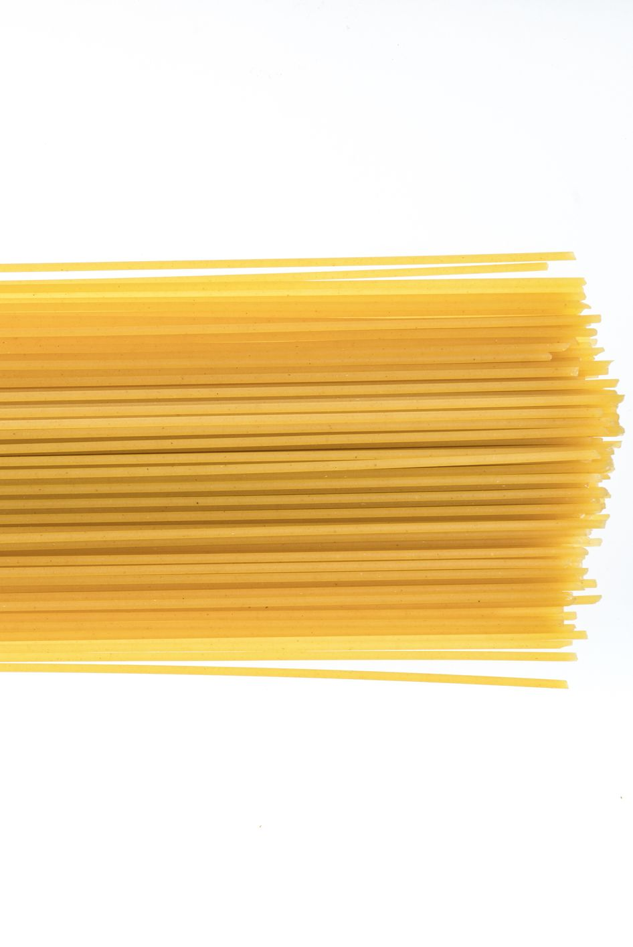
Feature Vector Description of Pasta
We’ve created a language for describing pasta that is useful for machine learning.
Your data is a feature vector - it isn’t a picture of pasta.
Pasta | Is it long? | Is it wide? | Is it stuffed?
Spaghetti | Y | N | N
Lasagne | Y | Y | N
Rigatoni | N | N | N
Ravioli | N | Y | Y
Connection to Module 2.5 - Word Embeddings - Our feature vectors for pasta is similar to the semantic space of the word embedding vectors we interacted with in the demo. Since word embeddings have many features (300) the computer figures out the features.
Notes:
This is the same idea of the semantic space of the word embedding vectors
Except in the word embedding vector - the computer figures out the features
These features dont’ have to be binary, it might have a numerical value
Is the length > of pasta

Slide 9
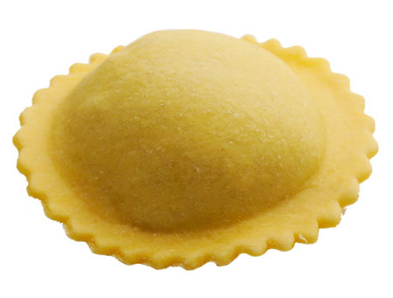
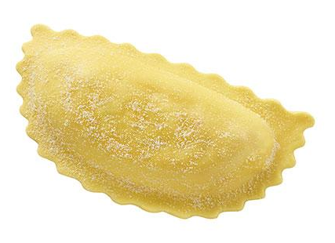
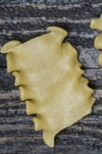
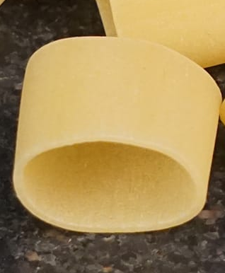
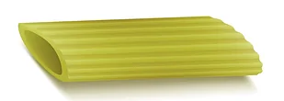
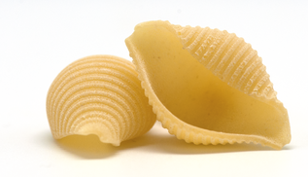
Use this test set to see how good your features are at classifying a new set of pastas
Ravioli
Mezzaluna
Mafaldine
Penne
Calamarata
Shell

Slide 10
Feature Vector Description of Pasta
Pasta
Spaghetti
Lasagne
Rigatoni
Ravioli
Notes:
This is the same idea of the semantic space of the word embedding vectors
Except in the word embedding vector - the computer figures out the features
These features dont’ have to be binary, it might have a numerical value
Is the length > of pasta

Slide 11
Test Set - Data Collection Sheet
Pasta | Correctly classified | Incorrectly classified
Spaghetti
Lasagne
Rigatoni
Ravioli

Slide 12
Reflection
How well did your pasta classifier do on this new test set? What pastas did it classify incorrectly?
Were your features flexible enough to allow you to classify new pasta? Why or why not?
How would you change your features to allow them to better classify a wider range of pastas?

Slide 13
Feature Vector Description of Pasta
Add more columns to fit all your features & more rows to fit all your pastas
Pasta
Spaghetti
Lasagne
Rigatoni
Ravioli
Notes:
This is the same idea of the semantic space of the word embedding vectors
Except in the word embedding vector - the computer figures out the features
These features dont’ have to be binary, it might have a numerical value
Is the length > of pasta

Slide 14
Takeaways

Slide 15
If your data is in a feature vector table like this then you don’t have to build the tree yourself
People don’t usually build decision trees by hand because for realistic tasks it can be hard.
For practical problems, people build a table that may have thousands of rows (examples) and dozens of columns (features). Each example is labeled with the correct decision (i.e., the class it belongs to).
Then they use a machine learning algorithm to create the decision tree.
Machine Learning is a process for constructing a reasoner (such as a decision tree classifier) using training data and a learning algorithm.

Slide 16
Pasta Land vs Mini-Akinator
Pastaland is a simulation of a machine learning algorithm
We knew all the examples/classes in advance
We knew all the features in advance
When we constructed the tree
  We used node splitting process
  We were selective about the features we chose in our tree
Used an algorithm to build the tree
Take away - The new way we build the tree in Pasta Land is what a machine learning algorithm will do for you.
Mini-Akinator - simulation of creating and growing a decision tree
We didn’t know the examples in advance
We didn’t know all the features in advance
Instead we added the examples one at a time and discovered the features as we went along
When we constructed the tree
  We grew it step by step because we added a new example
We couldn’t predict what to ask until we had another example
We might have to ask a lot more questions using this process.
Take away - We learned how to create and grow a decision tree and get some insight into how Akinator works.

Slide 17
Let’s look at some examples from the real-world

Slide 18
Try It #2: Think of a real-world example
Step 1: Pick a situation in the real world where computers might make decisions
Step 2: Think about the attributes that would contribute to making good decisions
Step 3: Reflection: Think about how your life is being affected by classifier systems (automated decision making).
Examples
Classifying toys based on age.
What kinds of features make a toy suitable?
Classify games, movies, and music
Reviewing loan applications.
What kinds of things help us determine the strength of a loan application?
College applications.
What kinds of things make for a strong college application?

Slide 19
Computers don’t learn the way people do.

Slide 20
How do people learn?
Discussion
Notes:
Answer - It solves a problem by asking a series of questions.

Slide 21
Ways people learn
Being taught by someone (e.g., parent, teacher, sibling, friend)
Asking questions
Observing others
Reading
Trial and error
Systematic experimentation
Everyday life experiences
Note: None of these are things that computers currently do well.

Slide 22
Ways Computers Learn
Learning from labeled examples (like Pasta Land and Teachable Machine)
  This is called supervised learning
  We will only explore supervised learning in this unit
Finding clusters in data
  This is called unsupervised learning because the data does not come pre-labeled
  Example: examining data on plants collected from a forest and decided how many different species of plants there are in the forest
Learning from experience via trial and error
  This is called reinforcement learning
  This is how computers learn good strategies for playing games
Learning by being told
  This is called zero shot learning.
  Large language models like ChatGPT can learn a new task by being told what to do and they will follow those instructions.
Notes:
Note - Learning by being told has been added in April 27,2023 to accommodate the appearance of ChatGPT

